Slide 1
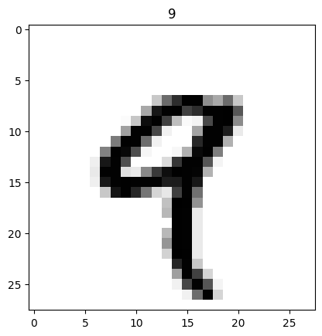
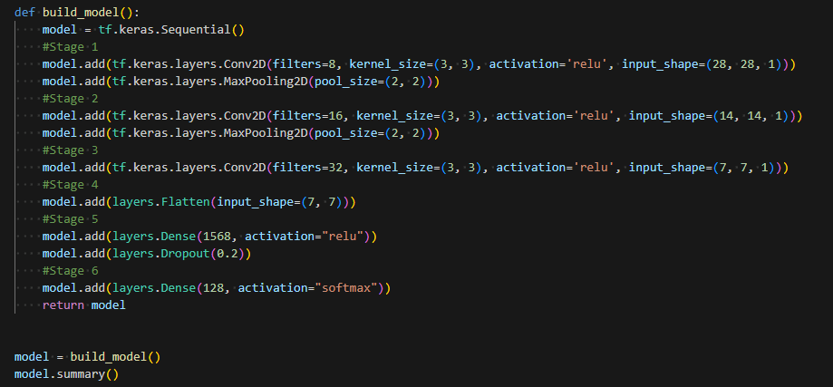
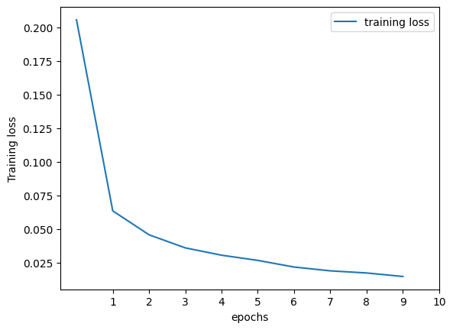
Q1: “Adam()” is an optimizer used to minimize the loss during training. It stands for Adaptive Moment Estimation. It combines the ideas of two other optimization algorithms: Momentum and RMSprop.
Q2: “sparse_categorical_crossentropy” is a loss function used in classification tasks when the labels are provided as integers (class indices). Unlike one-hot encoding, these assign fixed labels to the classes.
Q3: Epoch is complete pass through the entire training dataset during the training of a neural network. One epoch is completed when the model has seen and learned from every sample in the training dataset once. The epochs=10 means the model will go through the entire training dataset 10 times, adjusting its parameters to improve its performance.
Examples of Activation functions are:
Sigmoid, softmax, hyperbolic tangent, Rectified Linear Unit(ReLU), Leaky ReLU.
Alap Mundayoor, M.N. 23351429, IdM: ow07ysym

